Slide 1

Requirement Engineering process
Project Title : Road state and Road sign Notification Mobile Application
Authors
FOUYOU CHINJEH BRIAN
KANG JEVIS
ABANG BLESSING
VISEMIH JANICE
Instructor : DR NKEMENI VALERY

Slide 2
Table of content
Stake holder identification
Requirement gathering techniques (surveys, interviews, brainstorming, reverse engineering etc)
Data gathering
Data cleaning
User reluctance assesment
1. Stakeholder identification
We identify the people directly and indirectly involved by understanding the Cameroonian road ecosystem
These are the key stakeholders ;

Slide 3
Drivers(Commercial/private)
Ministry of Transport (MINTRANS)
Gendarmerie / Police Traffic Units
Local Councils
Third-Party Data Providers
Public Transport Companies (e.g., General Express, Finexs Voyages)
Commuters / Passengers
App Development Team
Crowdsourcing Users

Slide 4

Requirement Gathering Techniques
Gathering Authentic Needs from Road Users in Cameroon
Surveys
Distributed via WhatsApp, SMS & Facebook in major towns
(Douala, Buea, Bamenda, etc.)
Tools: Google Forms
(English & French)
User friendly
Cost effective
Graphical representations

Slide 5

Field Interviews Semi-structured discussions with: ⮚ Taxi & clando drivers ⮚ Private car users and passengers Locations: Areas like Muea, Mile 17. Brainstorming Sessions With my team members Focus: issues faced, road app usage

Slide 6

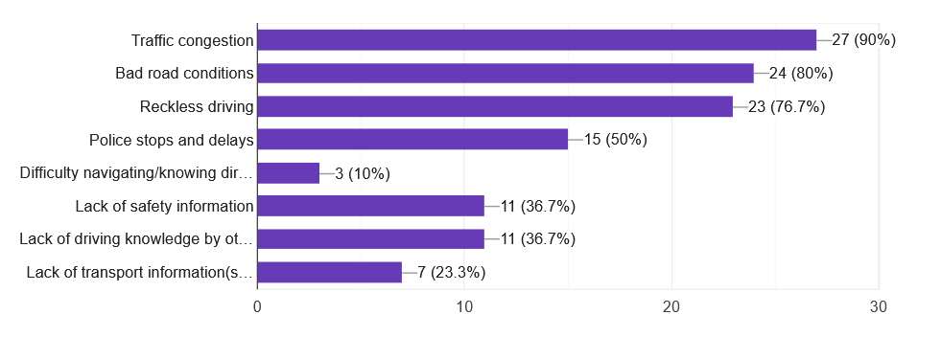
Studied the user experience and feature set of the following apps :
Waze: Good crowdsourcing, but lacks local road knowledge in Cameroon.
Google Maps: Poor coverage for local incidents or temporary hazards.

Slide 7
Data gathering
Shows data collected from; A) Surveys B) Inetviews

Slide 8
Data gathered by Survey

Slide 9
Data gathered from interviews
Unaware of the meaning of certain signs
Motorcyclist avoid using phone while riding
Smart phone literacy

Slide 10
Secondary Data Sources
MINTRANS road sign handbook (Cameroon)
Local news reports on road flooding and construction delays
Weather reports from Cameroon Meteorological Service
Public safety dashboards from apps like Cameroon Road Safety App,

Slide 11
Data cleaning
Step | Action Taken
Deduplication | Removed duplicate survey responses (same IP + name or phone number)
Validation | Filtered out inconsistent answers (e.g., “I drive daily” + “I don’t drive”)
Categorization | Grouped open responses like “bad roads”, “potholes”, “mud roads” into one tag
Text Normalization | Standardized regional expressions (e.g., “benskin” to “motorbike”, “gendarme stop” to “police checkpoint”)
Incomplete Removal | Discarded survey responses with more than 60% blanks

Slide 12
User Reluctance Assessment
User reluctance is the hesitation or unwillingness of users to adopt or engage with a new system. In our road sign and road state mobile notification app, understanding user reluctance is key to designing a helpful and widely adopted solution.
Introduction

Slide 13
Why It Matters for Our App
Our app uses GPS tracking, real-time alerts, and notifications.
These features can raise concerns or discomfort among users—especially drivers who value privacy and simplicity.
If these concerns aren't addressed, users might avoid using the app entirely

Slide 14
Key Factors Causing User Reluctance
Privacy concerns: Users may not want constant location tracking.
Battery/data usage: Real-time updates may drain device resources.
Too many alerts: Frequent notifications while driving can be distracting.
Complex interface: A difficult-to-use interface discourages adoption.
Doubt in reliability: If data isn’t accurate, users won’t trust the app.
Integration issues: Users may want the app to work with apps they already use like Google Maps or Waze.

Slide 15
Solutions to Reduce User Reluctance
Privacy control: Let users turn GPS tracking on/off when needed.
Lightweight design: Optimize app to use less battery and data.
Custom alerts: Allow users to choose what types of alerts they want.
Simple user interface: Easy to use while driving or quickly glancing.
Accurate data sourcing: Use crowdsourcing + official data to ensure reliability.
Navigation integration: Sync with users’ preferred mapping apps.

Slide 16
Conclusion
For our mobile app the key requirement are;
Requirement | Source
Real-time voice alerts for hazards and road signs | Surveys, interviews, Revers engineering
Low-bandwidth and battery-optimized mobile experience | Interview + survey analysis
Customizable notification settings | Survey (58%)
Localized hazard reporting (motorcycle, checkpoints) | Interviews with riders + drivers
Anonymous and fast crowdsourced reporting | Surveys + brainstorming
Road sign interpretation guide | Interview with rural drivers
Integration with existing map apps (optional) | Reverse Engineering (Waze)

